Slide 1

Lesson 2- HTML/CSS Basics

Slide 2
Basic HTML

Slide 3
Hypertext Markup Language (HTML)
describes the content and structure of information on a web page
not the same as the presentation (appearance on screen)
surrounds text content with opening and closing tags
each tag's name is called an element
syntax: <element> content </element>
example: <p>This is a paragraph</p>
most whitespace is insignificant in HTML (ignored or collapsed to a single space)
we will use a stricter, more standard version called XHTML

Slide 4
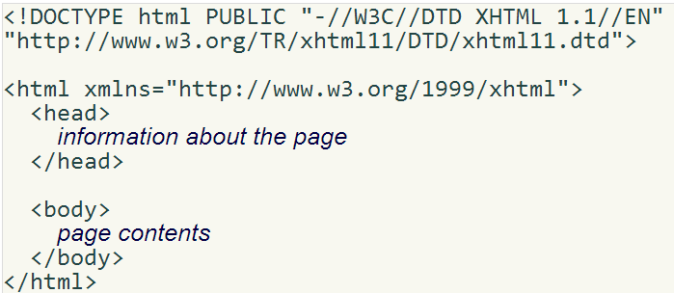
Structure of an XHTML page
the header describes the page and the body contains the page's contents
an HTML page is saved into a file ending with extension .html

Slide 5
Page title: <title>
describes the title of the web page
<title>Chapter 2: HTML Basics</title>
placed within the head of the page
displayed in the web browser's title bar and when bookmarking the page

Slide 6
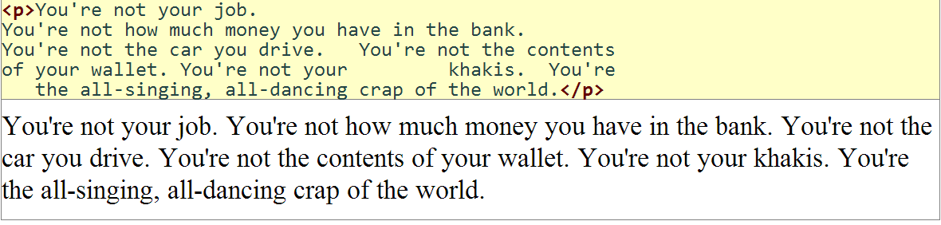
Paragraph: <p>
placed within the body of the page

Slide 7
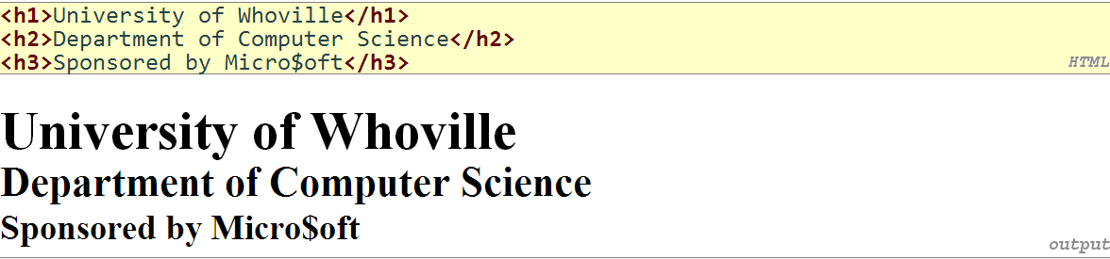
Headings: <h1>, <h2>, ..., <h6>
headings to separate major areas of the page (block)

Slide 8
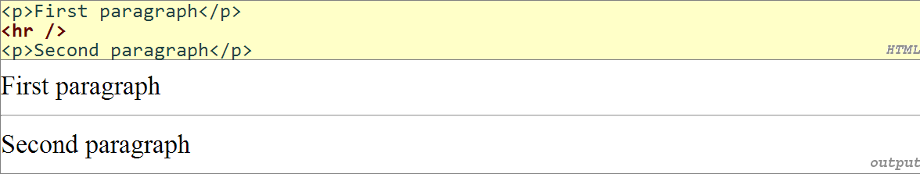
Horizontal rule: <hr>
a horizontal line to visually separate sections of a page (block)
should be immediately closed with />

Slide 9
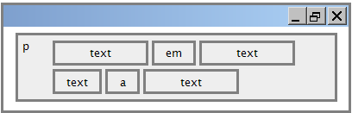
Block and inline elements
block elements contain an entire large region of content
examples: paragraphs, lists, table cells
the browser places a margin of whitespace between block elements for separation
inline elements affect a small amount of content
examples: bold text, code fragments, images
the browser allows many inline elements to appear on the same line
must be nested inside a block element

Slide 10
More about HTML tags
some tags can contain additional information called attributes
syntax: <element attribute="value" attribute="value"> content </element>
example: <a href="page2.html">Next page</a>
some tags don't contain content; can be opened and closed in one tag
syntax: <element attribute="value" attribute="value" />
example: <hr />
example: <img src="bunny.jpg" alt="pic from Easter" />

Slide 11
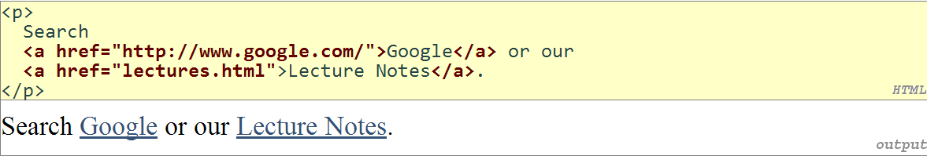
Links: <a>
links, or "anchors", to other pages (inline)
uses the href attribute to specify the destination URL
can be absolute (to another web site) or relative (to another page on this site)
anchors are inline elements; must be placed in a block element such as p or h1

Slide 12
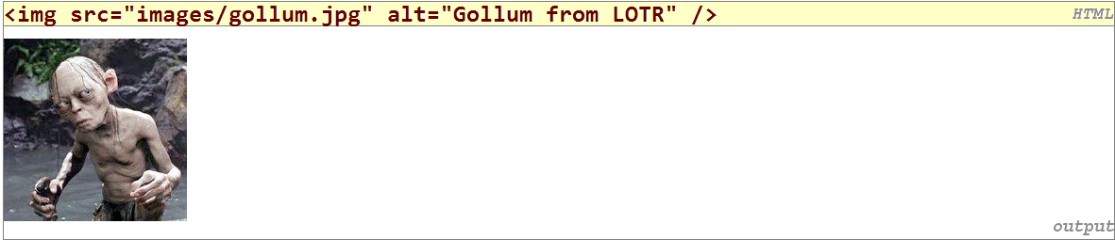
Images: <img>
inserts a graphical image into the page (inline)
the src attribute specifies the image URL
XHTML also requires an alt attribute describing the image

Slide 13
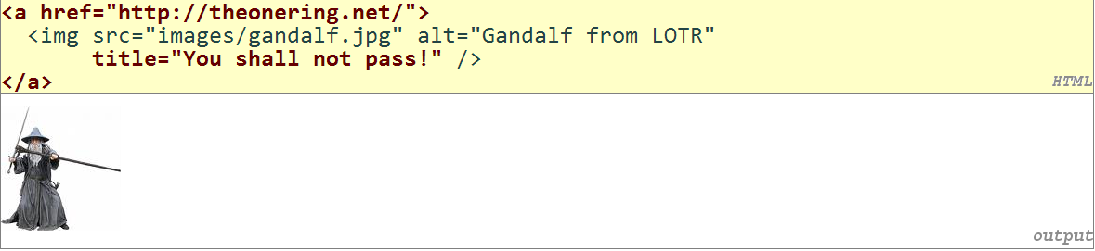
More about images
if placed inside an a anchor, the image will become a link
the title attribute specifies an optional tooltip

Slide 14
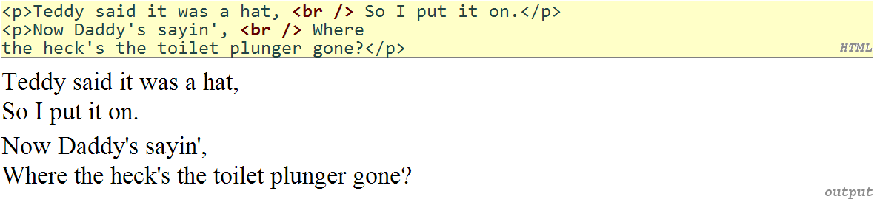
Line break: <br>
forces a line break in the middle of a block element (inline)
br should be immediately closed with />

Slide 15
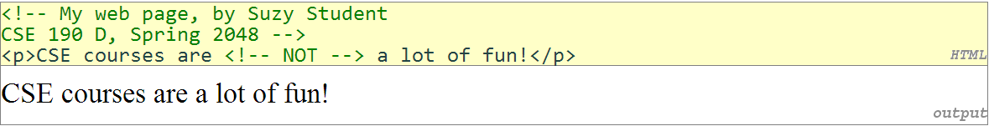
Comments: <!-- ... -->
comments to document your HTML file or "comment out" text
many web pages are not thoroughly commented (or at all)
comments are still useful for disabling sections of a page
comments cannot be nested and cannot contain a --

Slide 16
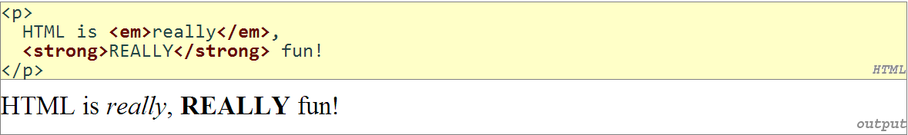
Phrase elements : <em>, <strong>
em: emphasized text (usually rendered in italic) strong: strongly emphasized text (usually rendered in bold)
as usual, the tags must be properly nested for a valid page

Slide 17
Nesting tags
Bad
tags must be correctly nested
(a closing tag must match the most recently opened tag)
the browser may render it correctly anyway, but it is invalid XHTML

Slide 18
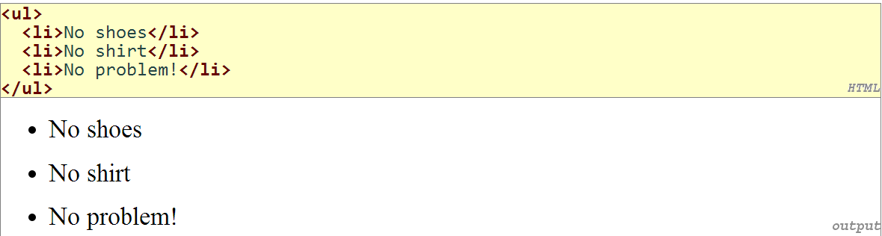
Unordered list: <ul>, <li>
ul represents a bulleted list of items (block) li represents a single item within the list (block)

Slide 19
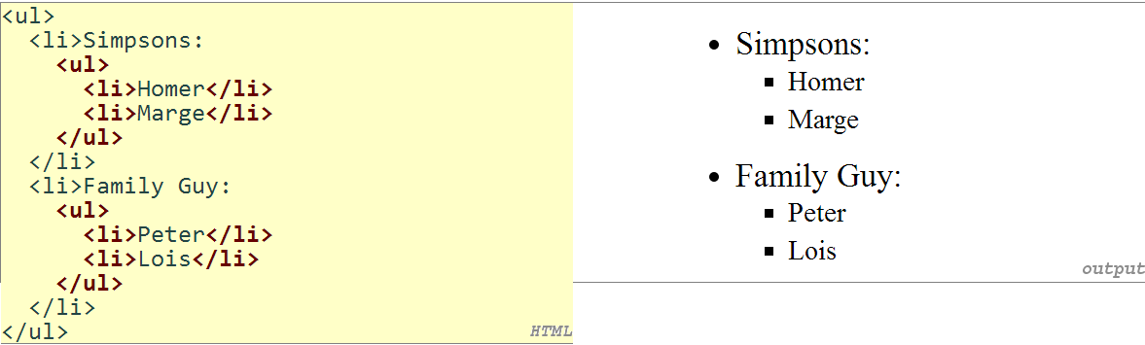
More about unordered lists
a list can contain other lists:

Slide 20
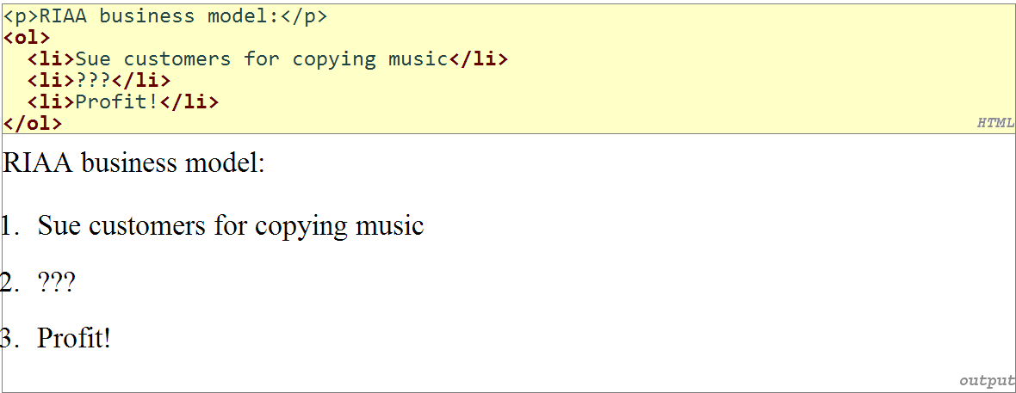
Ordered list: <ol>
ol represents a numbered list of items (block)

Slide 21
Web Standards
It is important to write proper XHTML code and follow proper syntax.
Why use XHTML and web standards?
more rigid and structured language
more interoperable across different web browsers
more likely that our pages will display correctly in the future

Slide 22
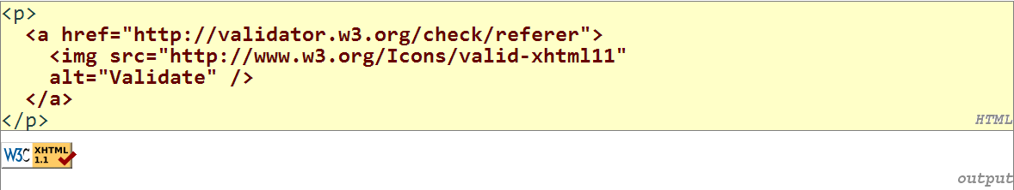
W3C XHTML Validator
validator.w3.org
checks your HTML code to make sure it follows the official XHTML syntax
more picky than the browser, which may render bad XHTML correctly

Slide 23
Exercise 1: About Me Page
Create a page named aboutme.html that describes you. On your page, include some or all of the following information:
Your name
A description of yourself in two sentences or less. Emphasize the most important word(s) by putting them in bold.
A list of classes you are taking right now at NSBM.
Your 3 favorite movies, books, or TV shows, in order. Make at least one link to an interesting site about that tv show/movie/book, such as its IMDB page.
Two images, one that represents you when you're happy and the other to represent you when you're sad. (These can be any images you like. Consider searching for images on Google Image Search)
Something interesting about one or more of your neighbors (people sitting at computers next to you)

Slide 24
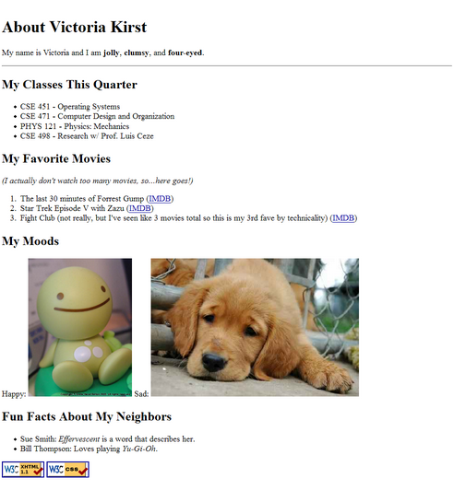

Slide 25
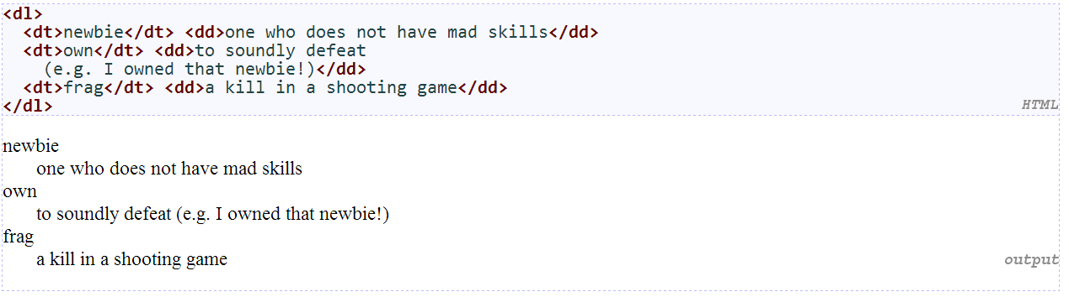
Definition list: <dl>, <dt>, <dd>
dl represents a list of definitions of terms (block) dt represents each term, and dd its definition

Slide 26
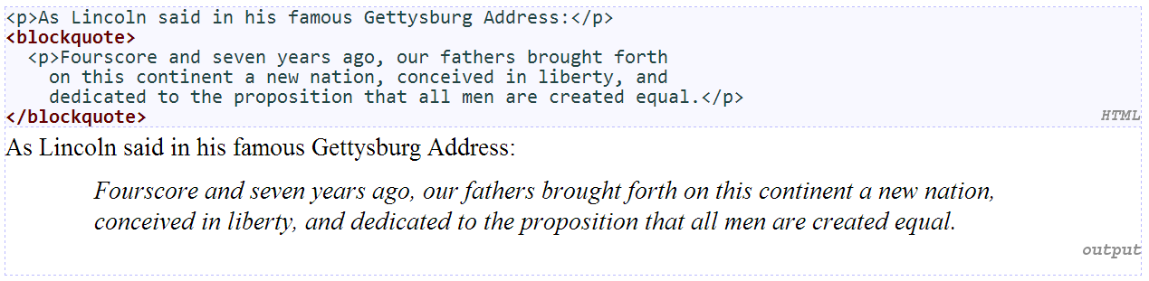
Quotations: <blockquote>
a lengthy quotation (block)

Slide 27
Inline quotations: <q>
a short quotation (inline)
Why not just write the following? <p>Quoth the Raven, "Nevermore."</p>

Slide 28
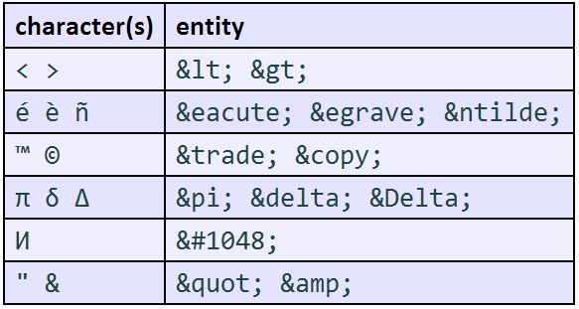
HTML Character Entities
a way of representing any Unicode character within a web page

Slide 29
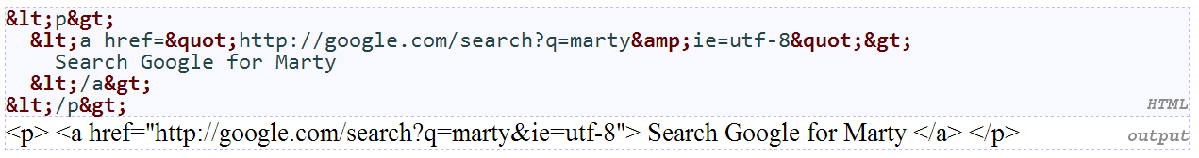
HTML-encoding text
To display the link text in a web page, its special characters must be encoded as shown above

Slide 30
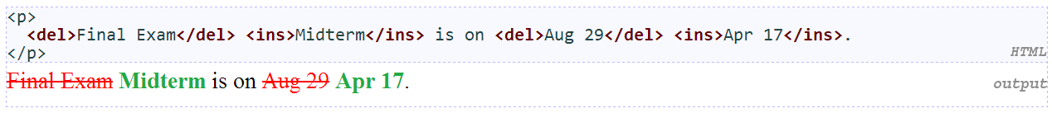
Deletions and insertions: <del>, <ins>
content that should be considered deleted or added to the document (inline)

Slide 31
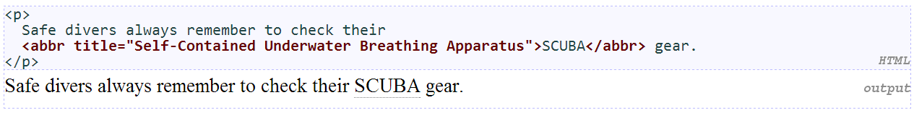
Abbreviations: <abbr>
an abbreviation, acronym, or slang term (inline)

Slide 32
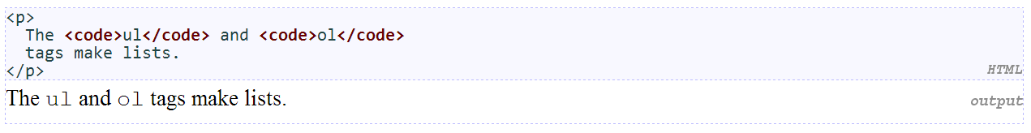
Computer code: <code>
a short section of computer code (usually shown in a fixed-width font)

Slide 33
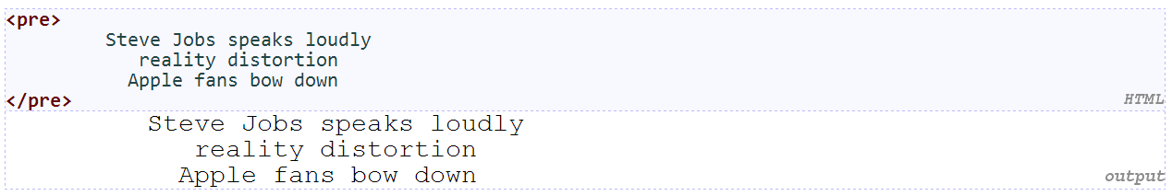
Preformatted text: <pre>
displayed with exactly the whitespace / line breaks given in the text
shown in a fixed-width font by default
how would it look if we had instead enclosed it in code tags?

Slide 34
Web page metadata: <meta>
information about your page (for a browser, search engine, etc.)
placed in the head section of your HTML page
meta tags often have both the name and content attributes
some meta tags use the http-equiv attribute instead of name
the meta tag with charset attribute indicates language/character encodings
using a meta tag Content-Type stops validator "tentatively valid" warnings

Slide 35
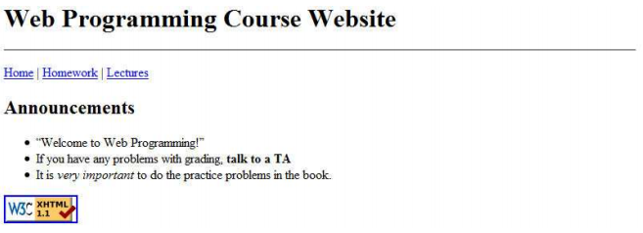
Exercise 2
Course Website: Write valid HTML code to generate the following content

Slide 36
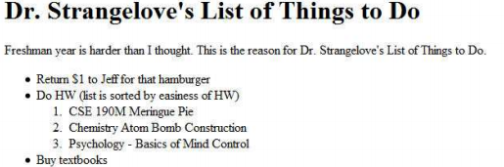
Exercise 3
Dr. Strangelove’s To-Do List: Write valid HTML code to generate the following content:

Slide 37
Basic CSS

Slide 38
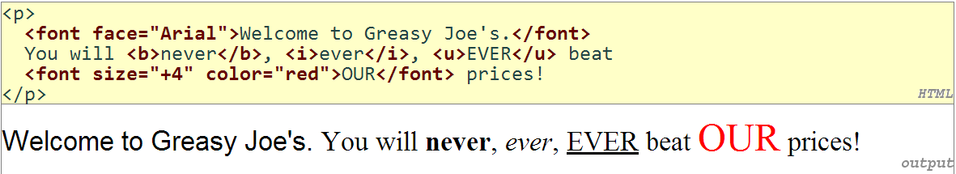
The bad way to produce styles
tags such as b, i, u, and font are discouraged in strict XHTML
Why is this bad?

Slide 39
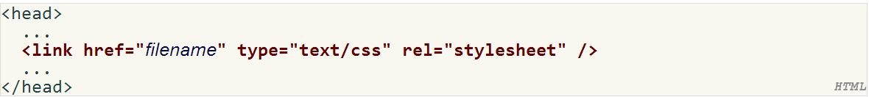
Cascading Style Sheets (CSS): <link>
CSS describes the appearance and layout of information on a web page
(as opposed to HTML, which describes the content of the page)
can be embedded in HTML or placed into separate .css file (preferred)

Slide 40
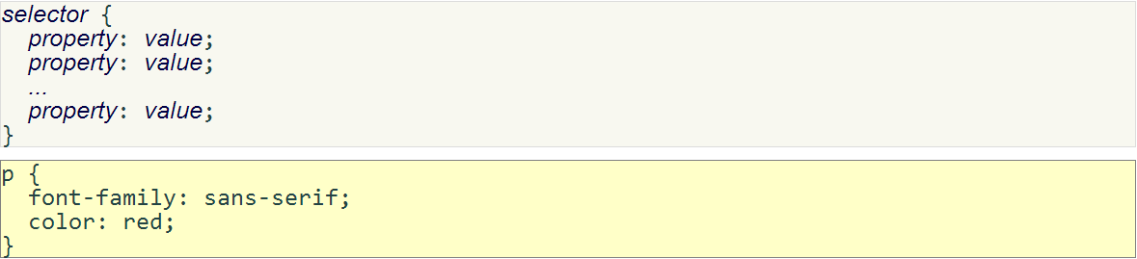
Basic CSS rule syntax
a CSS file consists of one or more rules
each rule starts with a selector that specifies an HTML element(s) and then applies styleproperties to them
a selector of * selects all elements

Slide 41
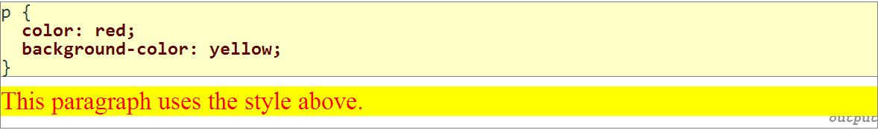
CSS properties for colors
property | description
color | color of the element's text
background-color | color that will appear behind the element

Slide 42
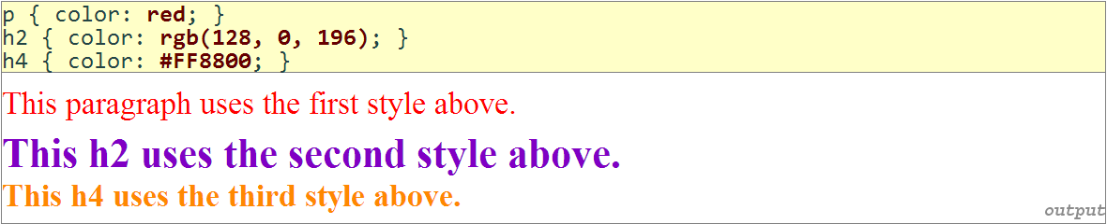
Specifying colors
color names: aqua, black, blue, fuchsia, gray, green, lime, maroon, navy, olive, purple, red, silver, teal,white (white), yellow
RGB codes: red, green, and blue values from 0 (none) to 255 (full)
hex codes: RGB values in base-16 from 00 (0, none) to FF (255, full)

Slide 43
CSS properties for fonts
property | description
font-family | which font will be used
font-size | how large the letters will be drawn
font-style | used to enable/disable italic style
font-weight | used to enable/disable bold style

Slide 44
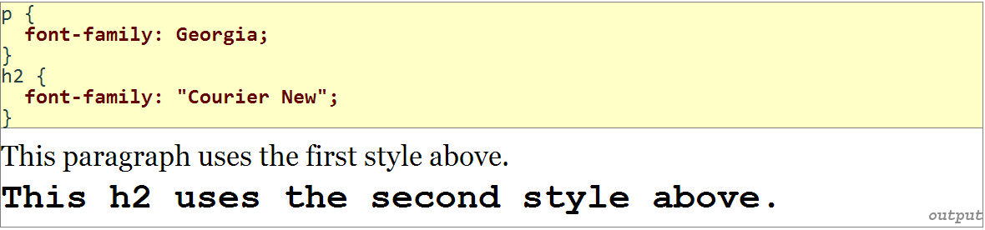
font-family
enclose multi-word font names in quotes

Slide 45
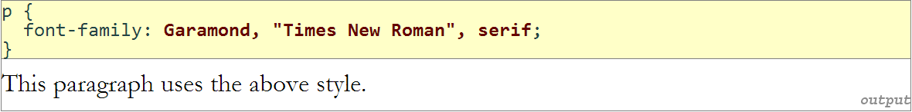
More about font-family
can specify multiple fonts from highest to lowest priority
generic font names: serif, sans-serif, cursive, fantasy, monospace

Slide 46
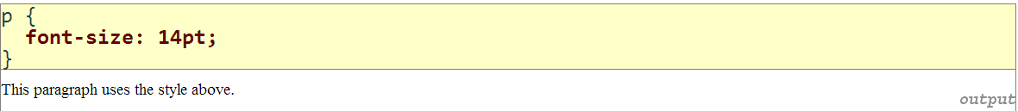
font-size
units: pixels (px) vs. point (pt) vs. m-size (em) 16px, 16pt, 1.16em
vague font sizes: xx-small, x-small, small, medium, large, x-large, xx-large, smaller, larger
percentage font sizes, e.g.: 90%, 120%

Slide 47
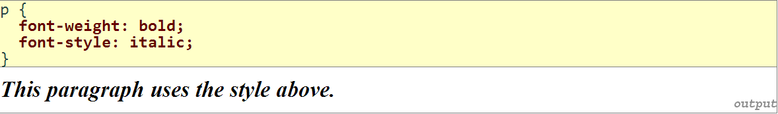
font-weight, font-style
either of the above can be set to normal to turn them off (e.g. headings)

Slide 48
Exercise 4: Style Your Page with CSS
Create a stylesheet named aboutme-style.css to improve the appearance of your About Me page. Your stylesheet should do the following without any modification to your HTML code:
Change the color of at least two elements
Change the font properties of at least two elements (such as family, size, weight, style). Here are some standard fonts you may want to use: Arial, Arial Black, Verdana, Trebuchet MS, Georgia, Tahoma, Courier New, Times New Roman
Change at least one other thing of your choosing (such as background color, text alignment, etc.)
For example, this is Victoria's styled version of her page in Exercise 1 :

Slide 49
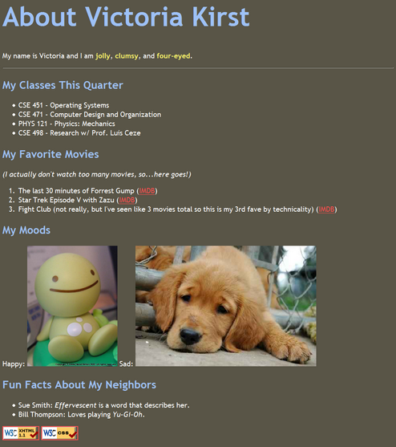

Slide 50
Q & A

